Slide 1


SAP Work Zone Hands-On: UI Integration Cards

Slide 2



Welcome to our speaker(s)!
Desiree Möller
Presales BTP
Mat Beerkens
Presales BTP
Timo Renner
Consulting IDG

Slide 3

Learning Objectives
End-2-End Demo with a No-Code approach
Concept of UI Integration Cards
Integration in SAP Work Zone

Slide 4
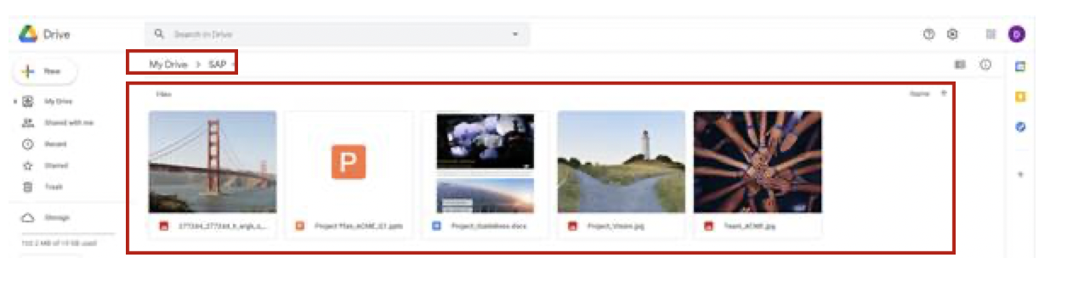
Prerequisites for this Session:
Create a SAP BTP Trial account (we will use Business Application Studio and Integration Suite) https://developers.sap.com/tutorials/hcp-create-trial-account.html
Create Business Application Studio Trial instance https://blogs.sap.com/2020/03/06/sap-business-application-studio-trial-in-sap-cloud-platform-assigning-roles/ Please make sure you can access the Business Application Studio by assigning the correct roles to your user (see the blog post for details).
Create Integration Suite Trial instance, only Open Connectors capability will be used https://blogs.sap.com/2020/08/07/sap-cloud-platform-integration-suite-trial-is-now-available/ Please make sure you can access the Open Connectors capability by assigning the correct roles to your user (see the blog post for details) and provisioning the capability.
Create Google Drive account and create a folder named “SAP” and some example files (whatever you want) in the folder (see screenshot). Keep your login credentials at hand for the workshop. https://www.google.com/intl/en_in/drive/
Notes:
https://www.youtube.com/watch?v=fa8ozFRw4oM

Slide 5
Agenda
What is SAP Work Zone & What are UI Integration Cards? 15 Min
Hands-on: You develop your own UI Integration Card connecting live to Google Drive! 30 Min
Short summary and where you find more information 5 Min
Q&A 10 Min

Slide 6

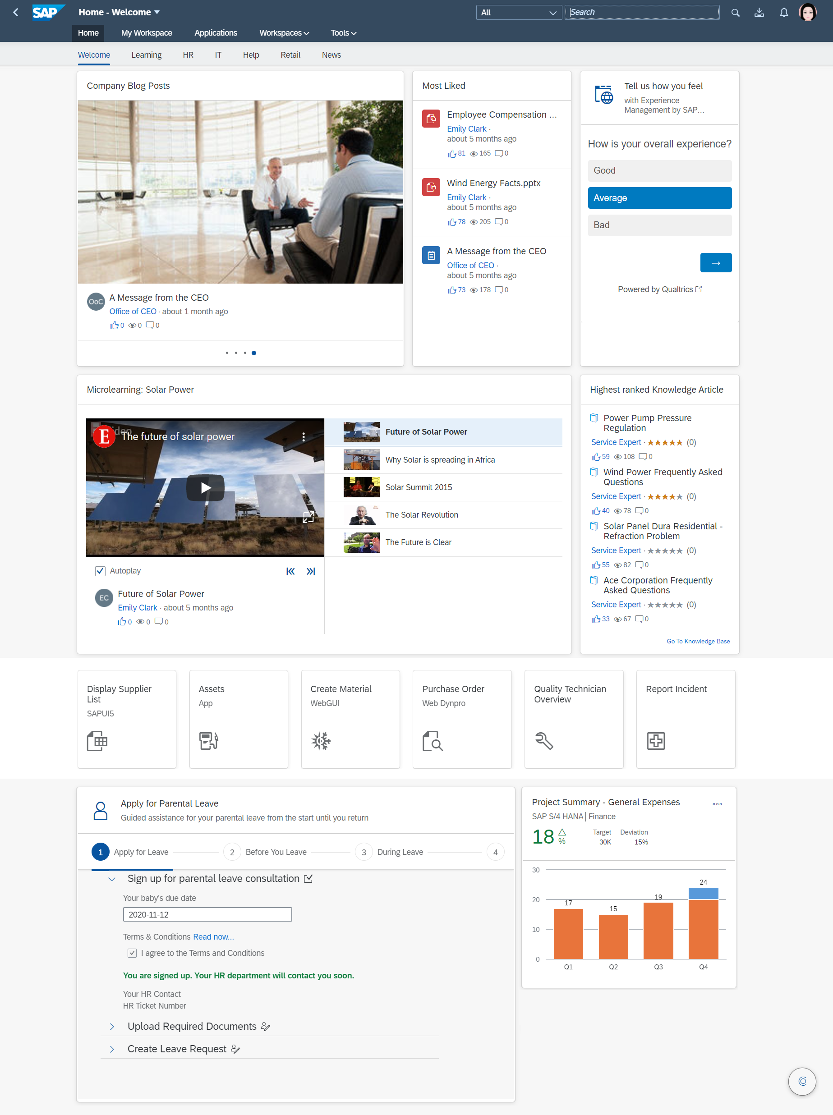











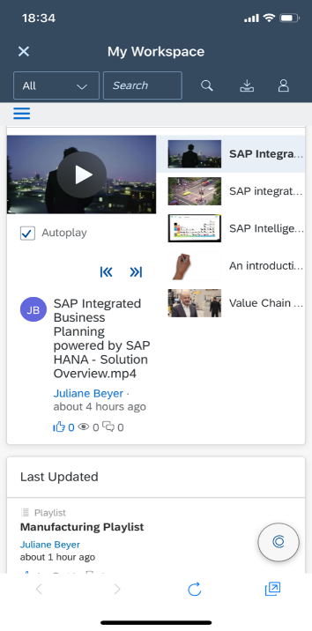




SAP Work Zone at a Glance
MY INBOX
Process workflow tasks that matter to you within the integrated My Inbox application
SELF SERVICE INTRANET
Easy-to-manage, self-service for the entire organization
SEARCH
Discover and find information with powerful content and document indexing
EMPLOYEE-FOCUSED
Personalized and easy to use with role-based data
INTEGRATE EXPERIENCE MANAGEMENT
Engage, monitor and measure with Qualtrics embedded within the experience
LAUNCHPAD
A centralized location for your SAP business applications, data and processes
KNOWLEDGE BASE
Create, retain and share knowledge across the entire organization
COMMUNICATE AND ENGAGE
Self-sufficient, freeform layout and drag-and-drop design to engage employees
SAP BUSINESS APPS
TEAM COLLABORATION
Quick access to SAP S/4HANA and other frequently used business apps
Self-service personal, project, topical, departmental and community workspaces
UI INTEGRATION CARDS
MOBILE READY
Embed and display SAP and third-party business data from across your organization
Anytime, anywhere access with responsive web and a dedicated mobile app
EXTEND AND DEVELOP
CREATE GUIDED WORKFLOW EXPERIENCES
Extend with full IDE based on SAP Business Application Studio
Use a template project to build guiding user experiences on top of workflows
INTEGRATE CONVERSATIONAL AI
Develop and integrate chatbots
Notes:
Now it’s time to walk through what we have in SAP Work Zone…

Slide 7















SAP Work Zone Architecture
Microsoft Applications
INTERNET
HTTPS
Subaccount: Cloud Foundry
Third-Party Applications
HTTPS
Design Time Environments
HTTPS
SAP Cloud Applications
UI Theme Designer
Business Application
Studio
Mobile Services
Workflow Management
Firewall
ON-PREMISE
Work Zone
Your Datacenter
Workspaces
Search
My Inbox
Notifications
Cloud Connector
HTTPS
Launchpad
Cards & Widgets
Content
...
Connectivity
Secure tunnel
Application Clients
Identity Authentication
Conversational AI
trust
or Business Suite

Slide 8
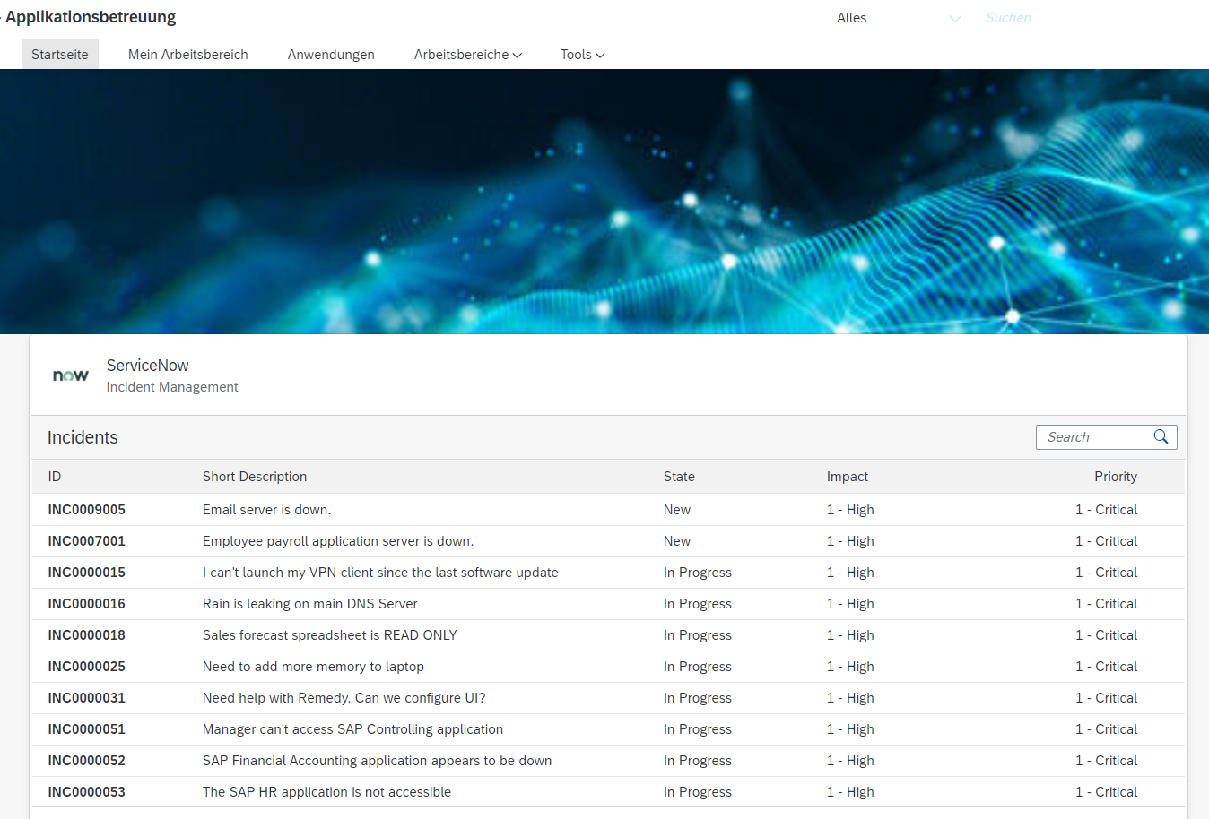
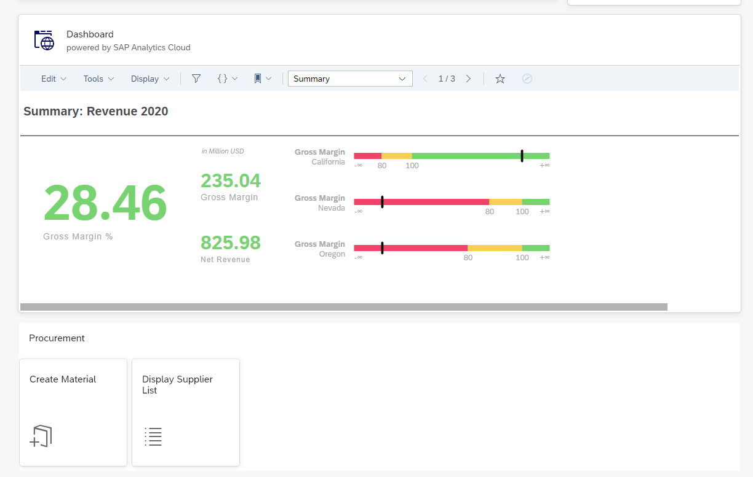
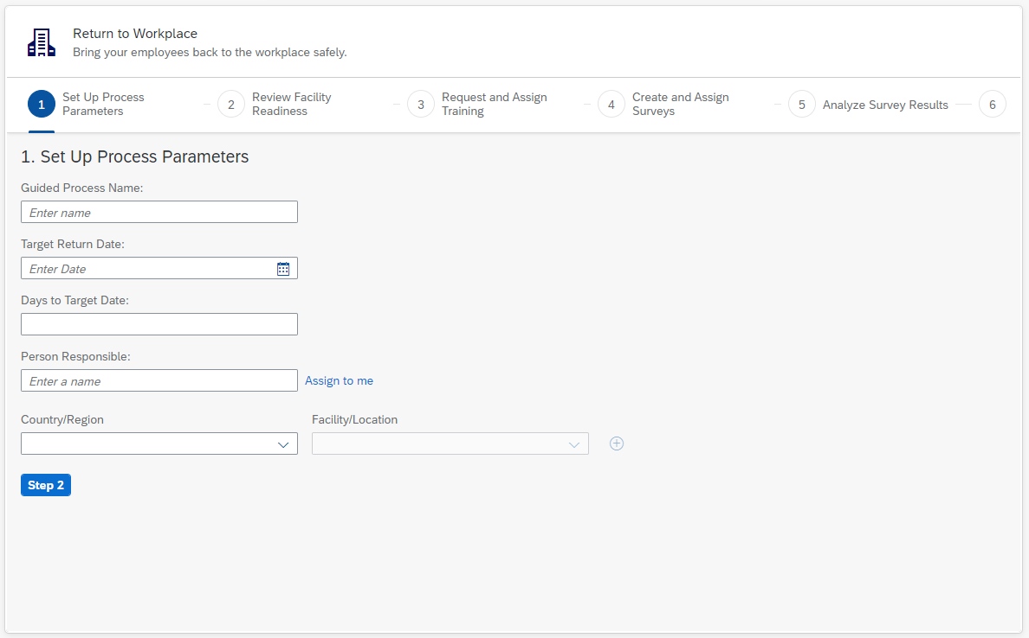
Integration Options in SAP Work Zone
via UI Integration Card
https://sapui5.hana.ondemand.com/test-resources/sap/ui/integration/demokit/cardExplorer/webapp/index.html
via iFrame
Standard widget within Work Zone called „Web Content Card“
via Fiori Applications supporting UI5, WebDynpro ABAP, GUI for HTML, Dynamic URL
via Workflows
* SAP Work Zone Workflow Journey App Template: https://github.com/SAP-samples/workzone-workflow-journey-app-template
Notes:
Different integration options allow you to find the right UI for the right data
Where does it make sense to show a preview, where an app and where an iframe?

Slide 9
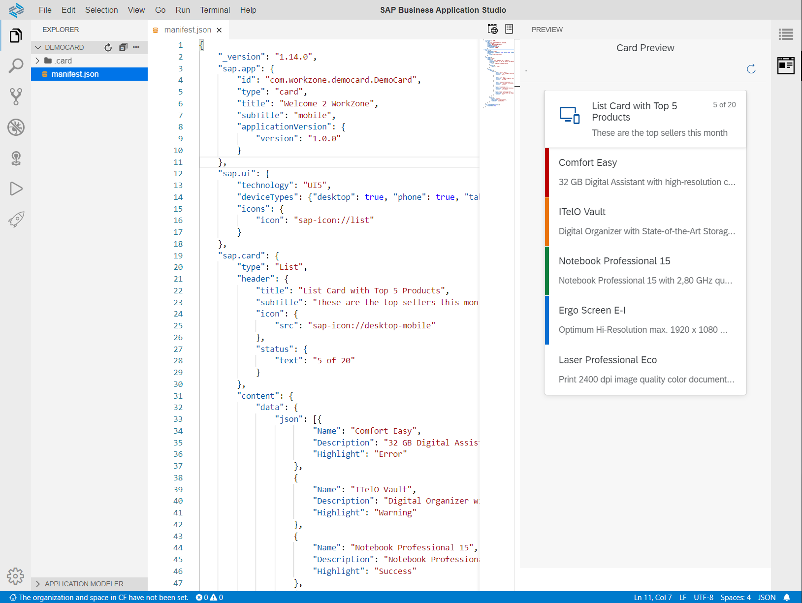
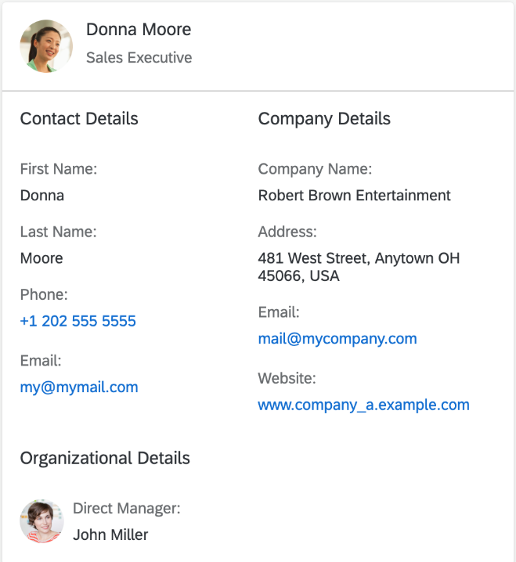
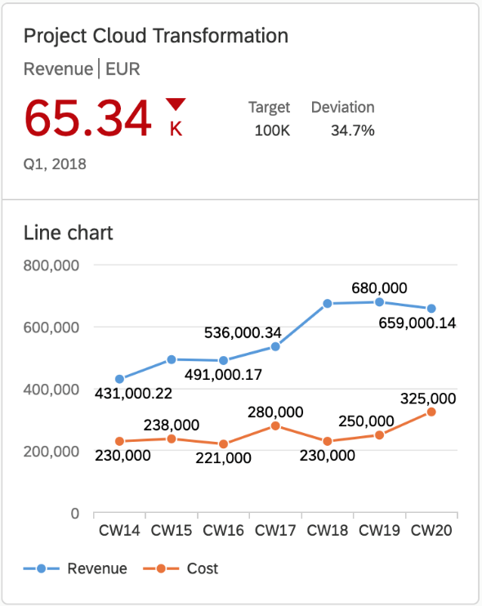
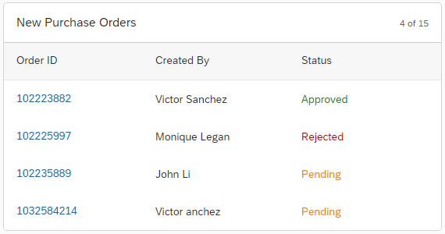
UI Integration Cards SAP Business Application Studio – SAP developer tools
UI Integration Cards:
Small content building blocks, consolidating data from different systems into one page
Cards from different business apps can be added to a workspace
SAP Business Application Studio based development environment for UI Integration Cards
Custom built cards can be leveraged to visualize external system content
Provides templates for various types of UI Integration Cards
https://sapui5.hana.ondemand.com/test-resources/sap/ui/integration/demokit/cardExplorer/webapp/index.html

Slide 10

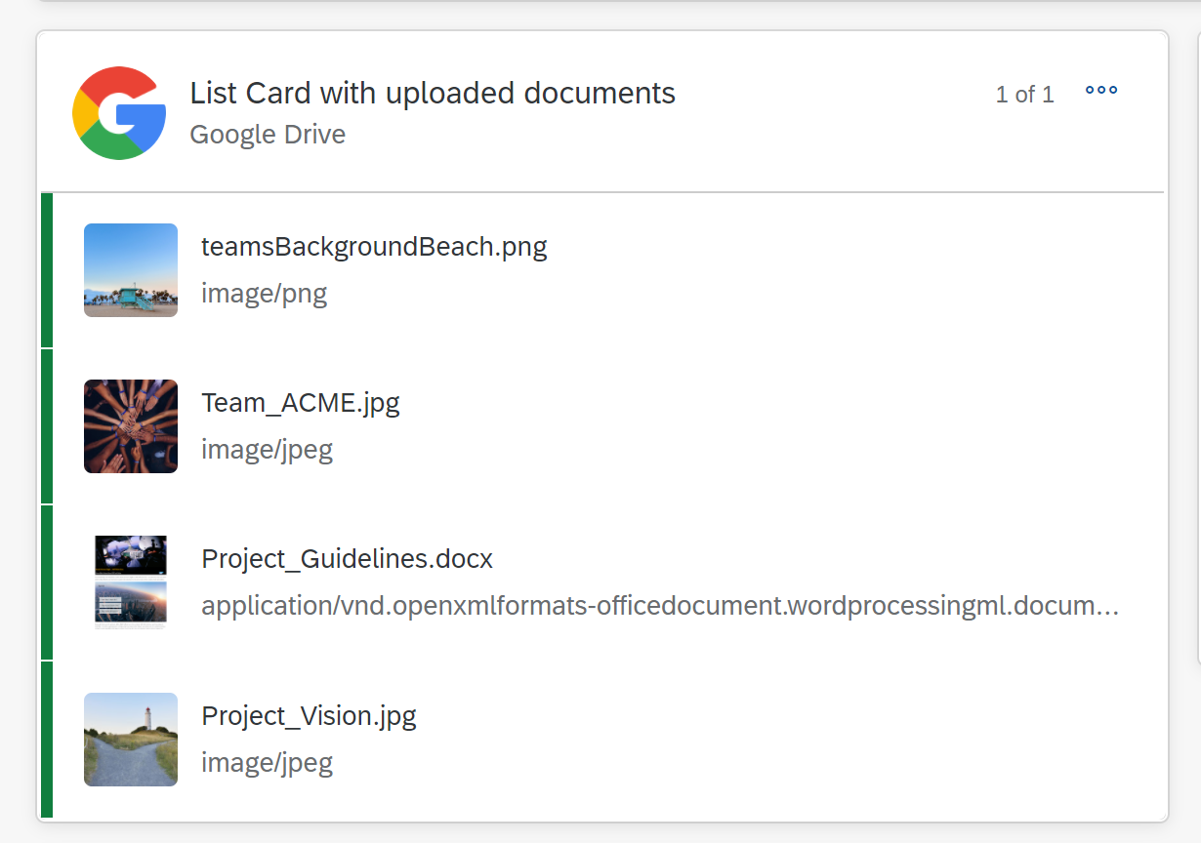
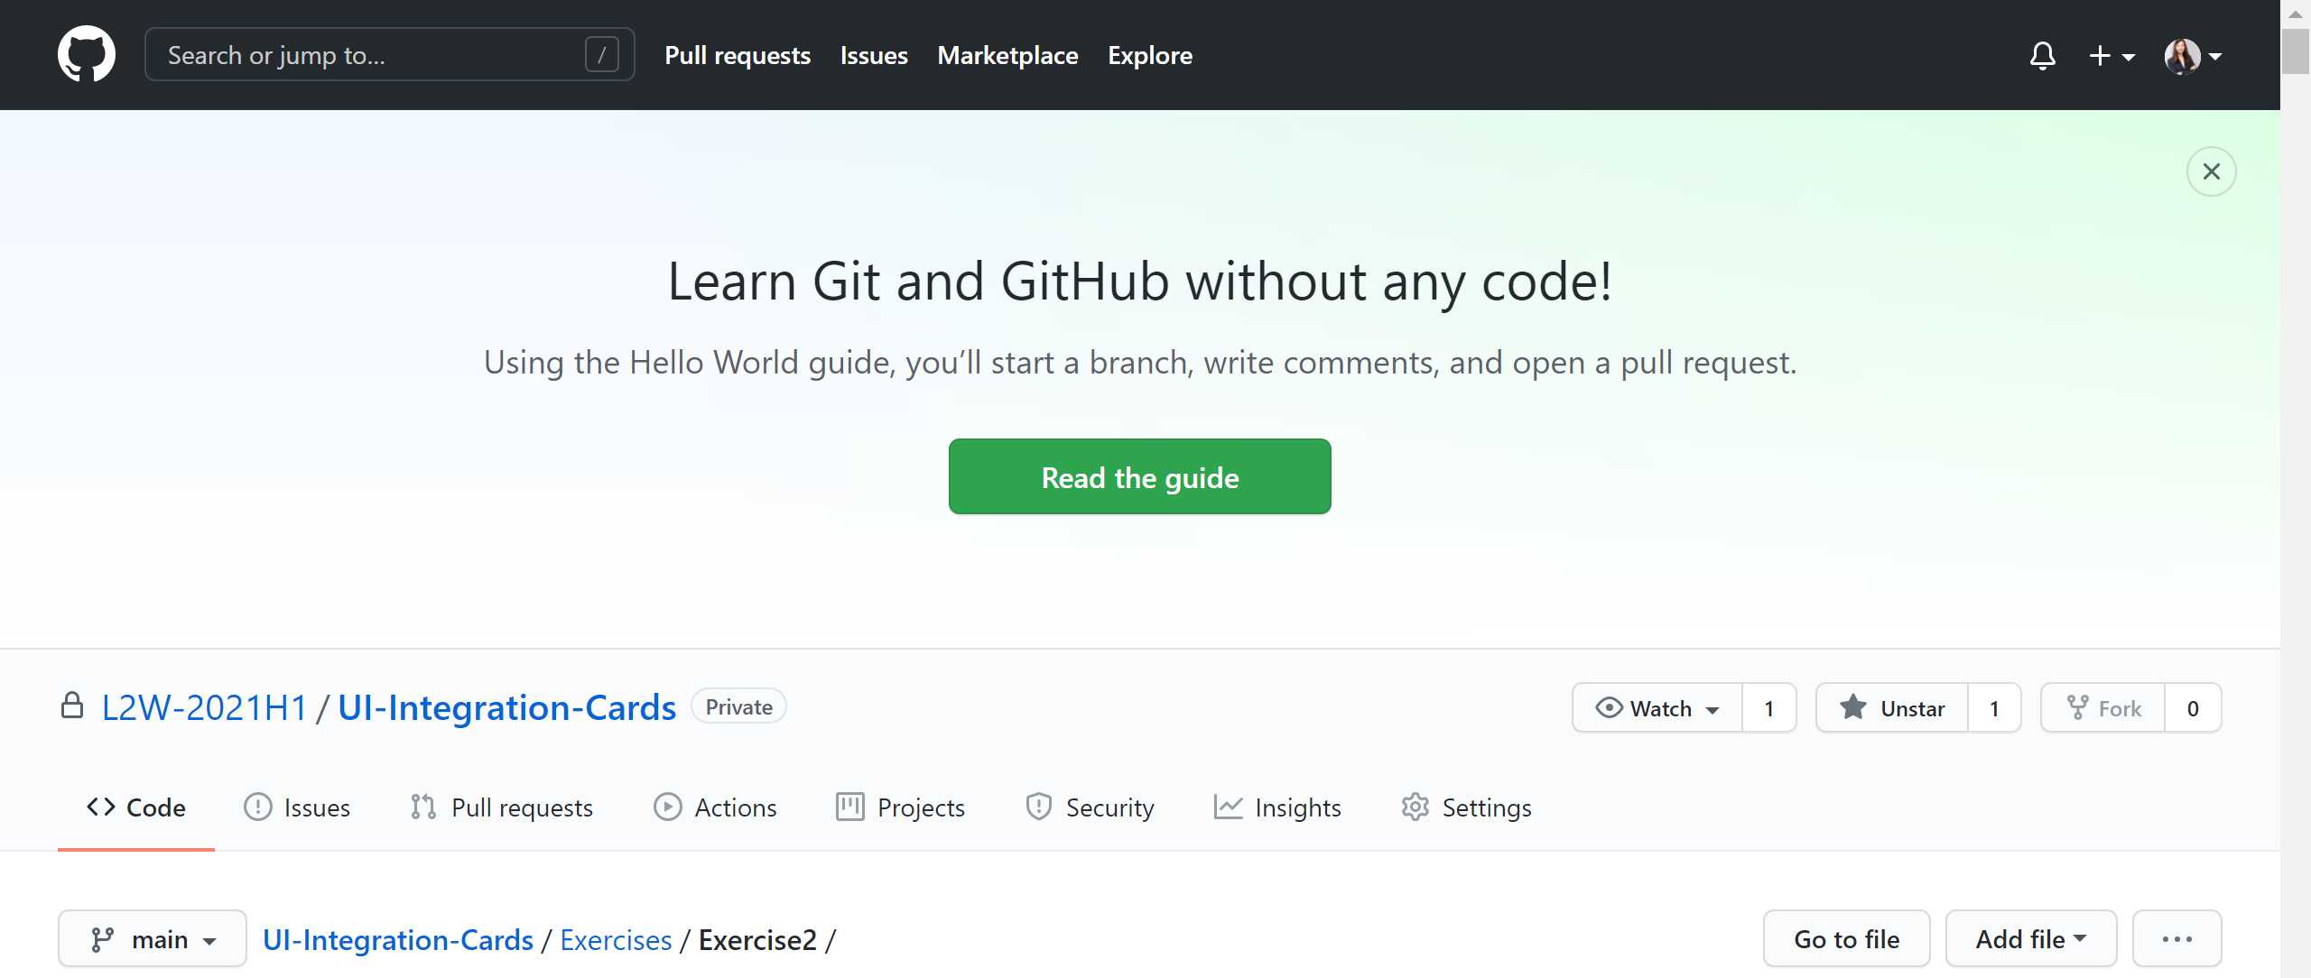
Goal
How-To
Link is in the chat

Slide 11
Agenda
What is SAP Work Zone & What are UI Integration Cards?
Hands-on: You develop your own UI Integration Card connecting live to Google Drive
Short summary and where you find more information

Slide 12
Hands-on part ends at XX:45

Slide 13
Agenda
What is SAP Work Zone & What are UI Integration Cards?
Hands-on: You develop your own UI Integration Card connecting live to Google Drive
Short summary and where you find more information

Slide 14

Further information
INTERNAL
SAP Internal
SAP Work Zone Enablement: https://jam4.sapjam.com/groups/Gzf5XdkPWGfbHBh64LWTdv/overview_page/gMdeShwumKtD8NLT2bFRy5 Parental Leave Demo at SAP Demo Store: https://sapdemostore.com/sap/bc/ui5_ui5/sap/yunifiedstore/index.html#/scenario/16520 Platform &Technologies Hub (official P&T enablement with Learn2Win content): https://jam4.sapjam.com/groups/8CM1sEjrBvPhgTUPYWxSAX/content?folder_id=SGocux1hPelKKcepsamVsp SAP PartnerEdge (SAP Work Zone for HR): https://partneredge.sap.com/en/library/education/products/emp_mng/hcm/sell/e_ep_sap_workzone_for_hr_unlocking_a_new_workplace_experience.html SAP Training Course (blog post explaining how to get access for SAP employees): https://jam4.sapjam.com/blogs/show/FUXNaocl43fsb2mUqaD6GG Forum (to ask questions in enablement group): https://jam4.sapjam.com/groups/Gzf5XdkPWGfbHBh64LWTdv/overview_page/IxijsCiHussFYCnESiIava

Slide 15

Q & A

Slide 16

Thank you.
Contact information:
F name L name
Title
Address
Phone number
Please rate this session
And take the Learn to Win Survey to help us improve.

